Slide 1


Connie Bagonza Tendo
10/15/2024

Slide 2

Outline
Executive Summary
Introduction
Methodology
Results
Conclusion
Appendix

Slide 3
Executive Summary
Summary of methodologies
Data collection through API and Web scraping
Data transformation with data wrangling
Exploratory data analysis with SQL, Pandas and Matplotlib
Generate a dashboard to analyze records interactively with Plotly Dash
Generate an interactive map to analyze the proximity with Folium
Apply Machine learning methodologies to determine if the first stage of Falcon 9 will land successfully
Summary of all results
Data analysis findings
Data visualizations
Interactive dashboards
Predictive models analysis
Recommendations

Slide 4
Introduction
Project background and context
The scenario for this project was that the commercial space age was finally here, and companies were making space travel more affordable and accessible for everyone. Despite this new revelation, the cost of launch continued to hinder new companies from thriving in this new industry
The goal for this project was to take on the role of a data scientist for a new space company, Space Y, aiming to collect data through various sources and train different Machine learning models to compete with the leading company, Space X, the rival company.
Space X is leading the game because by developing reusable rocket technology, Space X significantly lowered the cost of each launch, and this allowed for more frequent and affordable access to space.
Problems you want to find answers
Whether or not the first stage of Space X Falcon 9 will land successfully

Slide 5

Section 1

Slide 6
Methodology
Executive Summary
Data collection methodology: Data was collected by using the SpaceX API to perform GET requests.
Perform data wrangling: Data wrangling is cleaning and organizing data into usable format.
Data wrangling involved cleaning and organizing flight attributes e.g. (Flight Number, Date, etc. ) for analysis. Then, mission outcomes were converted into binary labels( 0 -unsuccessful, 1- successful) to train supervised models. Finally, once processed, the data was ready for exploratory analysis and predictive modeling to forecast mission success.
Perform exploratory data analysis (EDA) using visualization and SQL
Perform interactive visual analytics using Folium and Plotly Dash
Perform predictive analysis using classification models: The data is standardized and split into training tests. Then we find the best classification model between Logistic Regression, SVM, Decision Trees, and KNN using test data and the best algorithm is chosen based on its predictive accuracy.

Slide 7
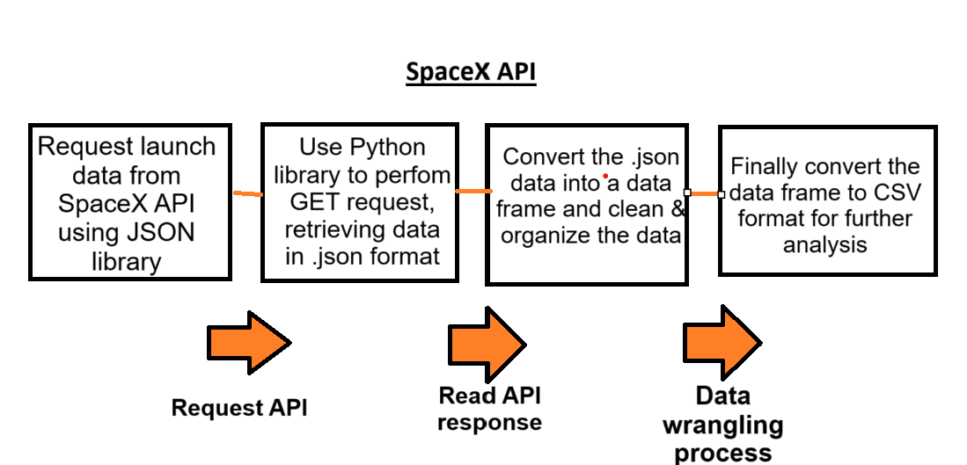
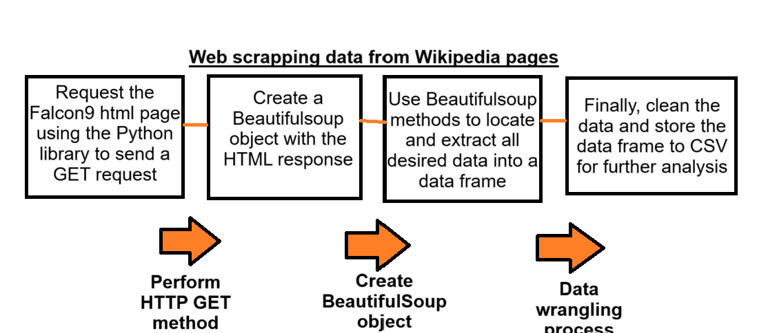
Data Collection
Data collection is the process of gathering data from various sources, the data for this project was collected from:
SpaceX REST API, providing data on past launches
And through Web scrapping relevant Wiki pages using BeautifulSoup.

Slide 8
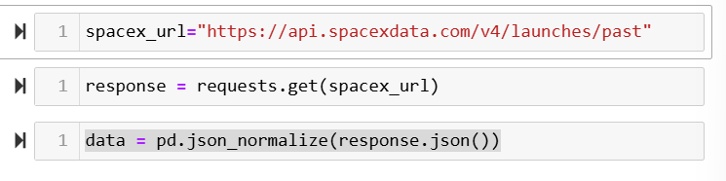
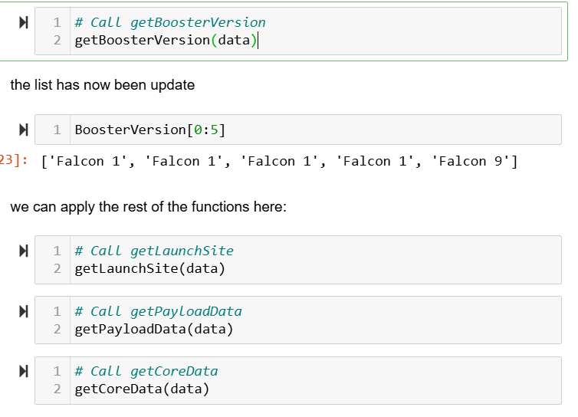
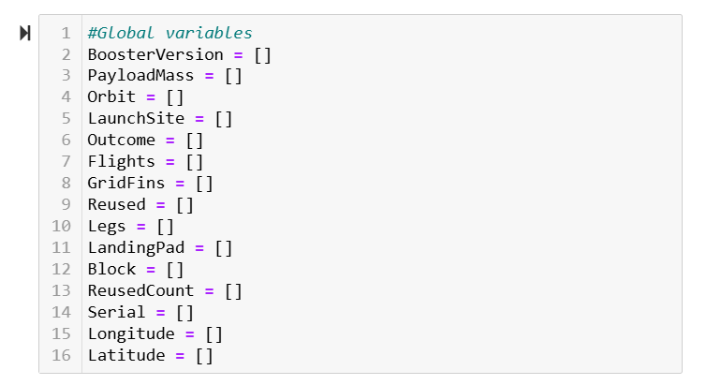
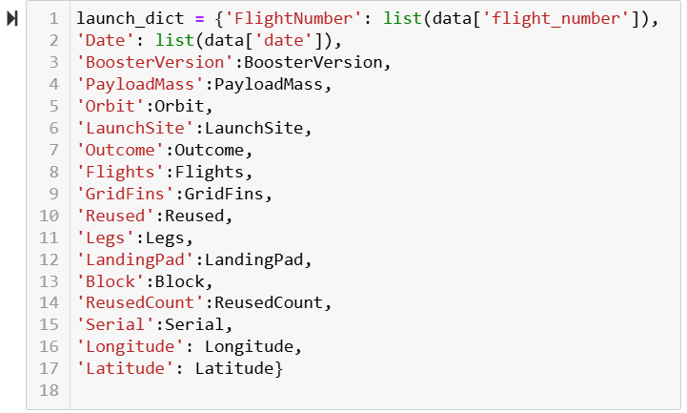
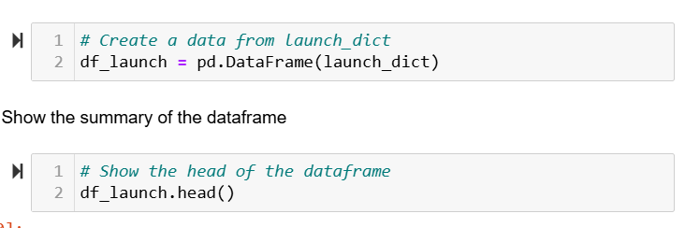
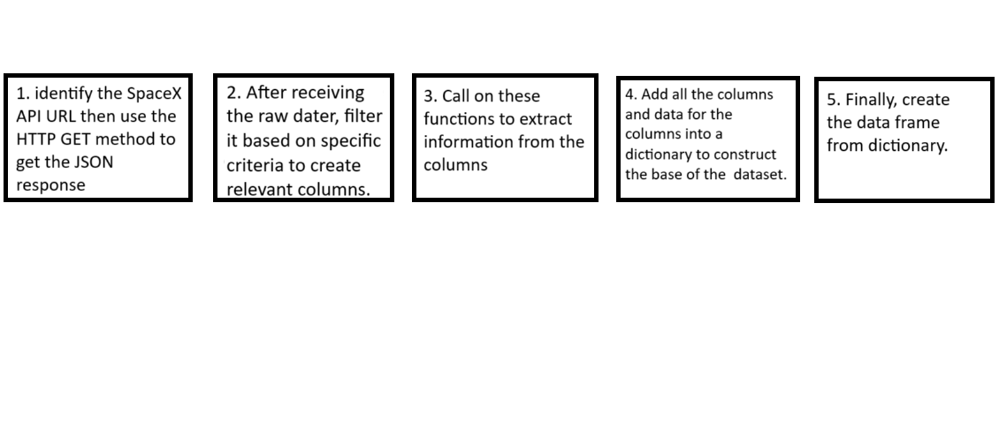


Data Collection – SpaceX API
1
3
2
4
5
1
2
3
4
5

Slide 9
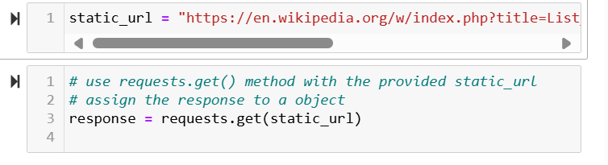
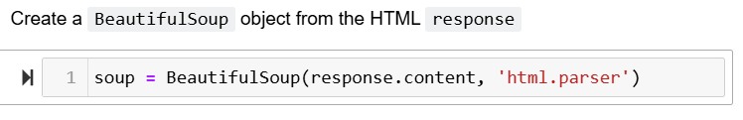
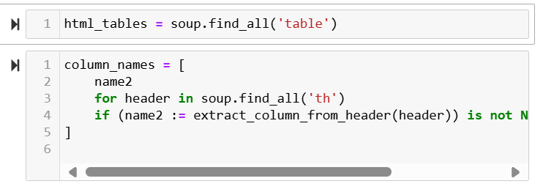
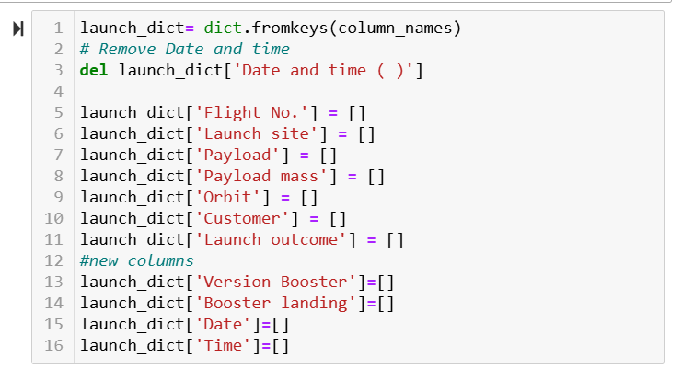
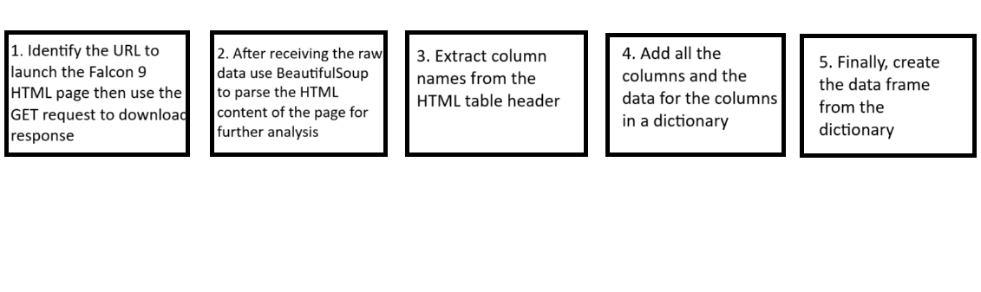
Data Collection - Scraping
2
1
3
4
5
1
2
3
4
5

Slide 10
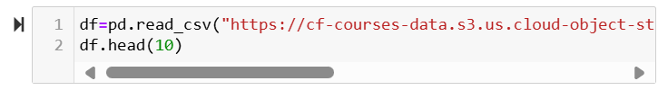
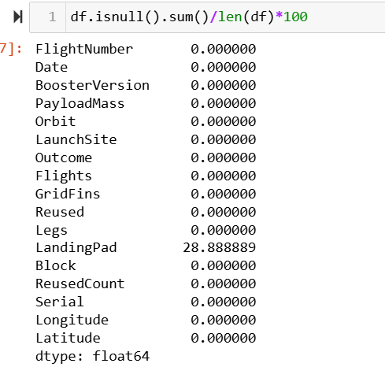
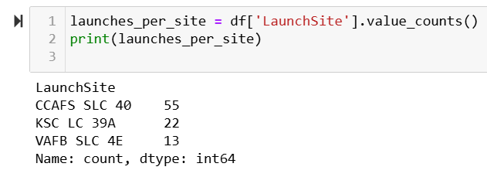
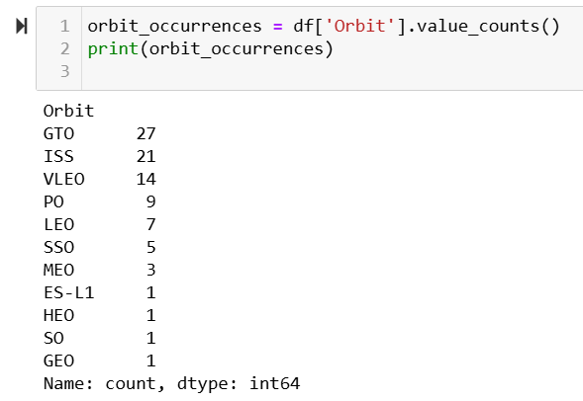
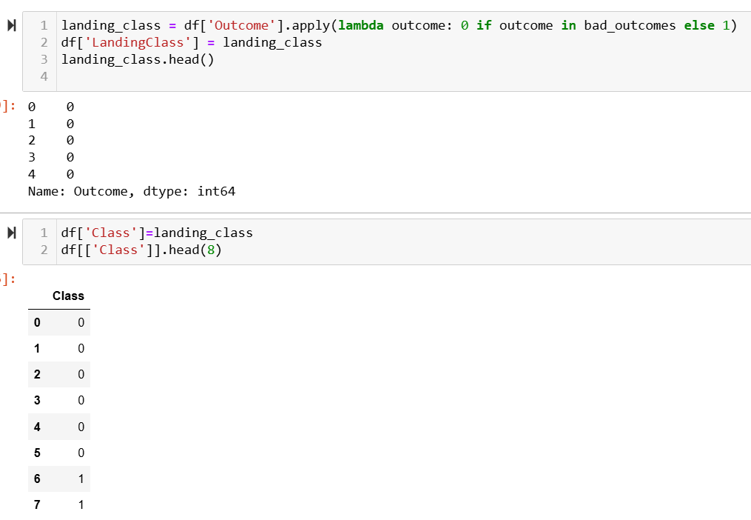
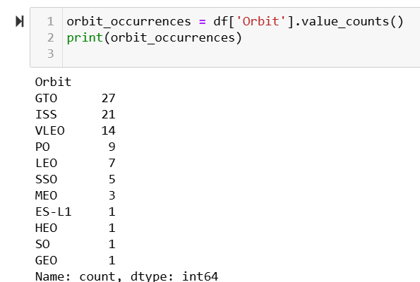
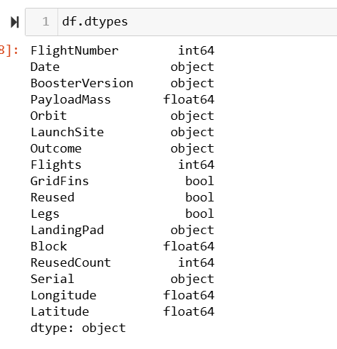
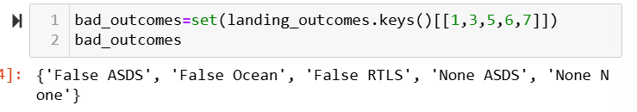
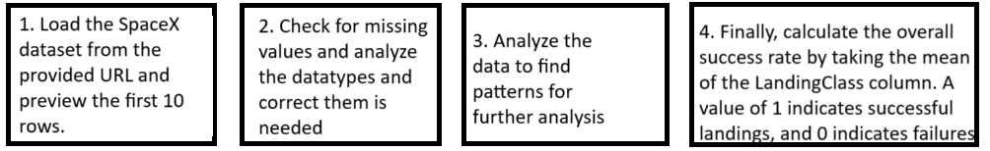
Data Wrangling
1
2
3
4
1
2
3
4

Slide 11
EDA with Data Visualization
Scatter plots: are typically used to explore relationships between two variables, making it easier to observe patterns.
Flight Number vs. Launch Site: I wanted to visualize the relationship between the frequency of launches (FlightNumber) and different launch sites used by SpaceX. I noticed that as the FlightNumber increases, the success rate for landings also increases and this reflects on SpaceX’s improvement over time.
Payload vs. Launch Site: I wanted to examine the distribution of payload masses across different launch sites, and I noticed no rockets launched with heavy payloads at the VAFB-SLC launch site.
Flight Number vs. Orbit Type: I wanted to examine how the frequency of flights (FlightNumber) correlates with different orbit types.
For the LEO (Low Earth Orbit), there was a positive relationship between FlightNumber and success, suggesting better chances for launch outcomes
Dor the GTO(Geostationary Transfer Orbit), there was no relationship, suggesting that other factors may influence the chances for launch outcomes.

Slide 12
EDA with Data Visualization +1
Payload vs. Orbit Type: I wanted to examine how the payload mass varied across different orbit types.
For the Polar. LEO, ISS there was a correlation between heavy payloads and successful landings.
For the GTO, the correlation was less clear because both successful and unsuccessful landings occur with heavy payloads.
Bar Charts: are typically useful for comparing categorical variables.
Success rate by orbit type: there was a correlation between the landing success rates of different orbit types. ES1-L1, GEO, HEO, and SSO had the highest bars indicating that launches to these orbits have high success rates. Additionally, GTO had the lowest bar indicating that launches to this orbit face more challenges.
Line Charts: are typically used to identify Falcon 9 first-stage landing trends over time.
Average yearly launch success: the success rate consistently increased since 2013, peaking around 2020, suggesting that SpaceX refined its technology over the years.

Slide 13
EDA with SQL
SQL queries to understand the SpaceX dataset better.
Unique Launch Sites: extracted names of unique launch sites from the space missions
Launch Sites starting with ‘CCA’: displayed five records with launch sites beginning with ‘CCA’.
Total Payload mass for NASA launches: calculated the total payload mass carried by boosters launched by NASA.
Average Payload mass for F9 v1.1: calculated the average payload mass carried by the booster version F9 v1.1
First Successful ground pad landing: displayed the date of the first successful landing outcome on a ground pad.
Boosters with Successful drone ship landing: displayed the names of boosters that were successful on a drone ship with a payload mass greater than 4000kg but less than 6000 kg
Mission outcomes summary: calculated the total number of successful and failed mission outcomes
Booster versions with maximum Payload mass: extracted the names of booster versions that have carried the maximum payload mass
Failed drone Ship landings in 2015: displayed the failed landing outcomes in drone ships in 2015
Ranking landing outcomes: ranked the count of landing outcomes (e.g., failure on drone ship, success on ground pad) between the dates 2010-06-04 and 2017-03-20 in dec order.

Slide 14
Build an Interactive Map with Folium
In the Launch Sites location Analysis, I developed an interactive map using Folium to analyze geospatial data related to launch sites. Various map objects were created to enhance the visualization of the Space X launch data.
Circles: were used to highlight the area around each launch site, making them stand out on the map
Markers: were used to identify and locate each launch site on the map.
MarkerClusters: were used to manage the successful and failed launch outcomes using different colored markers (green for success, red for failure)
MousePosition: was used to display the coordinates as the user navigates the map.
Polyline: lies were drawn between launch sites and select points e.g. the coastline.
Distance Markers: were added at select points e.g. the coastline, displaying the calculated distance from each launch site.

Slide 15
Build a Dashboard with Plotly Dash
The dashboard I built with Plotly Dash, displays real-time interactive visual analytics of the SpaceX launch data. These are the interactions I added to the dashboard:
The Launch Site dropdown menu feature allows a user to filter the entire dashboard by selecting specific launch data based on what they want to analyze.
The Success Rate pie Chart displays the success vs. failure for launches. This feature allows a user to select a specific launch site and then displays the success and failure rates for that site only.
The Payload Range Slider adjusts the range of payload mass to filter the data based on different payload values. This feature allows a user to explore how payload mass correlates with the mission outcome.
The Payload vs. success scatter plot displays the correlation between payload mass and mission success for all sites. This feature allows a user to analyze the relationship and make informed conclusions for the analysis.

Slide 16
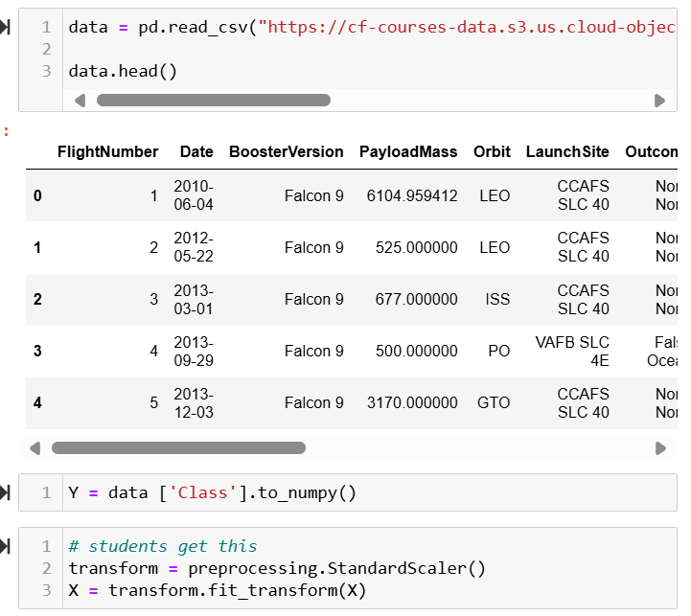
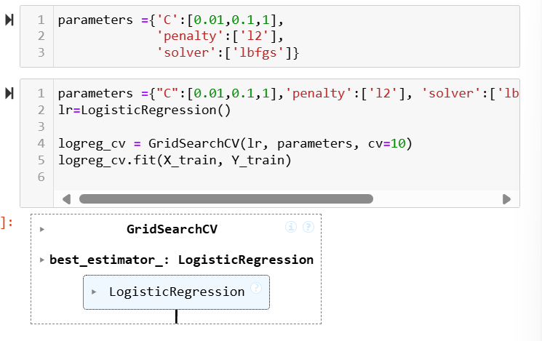
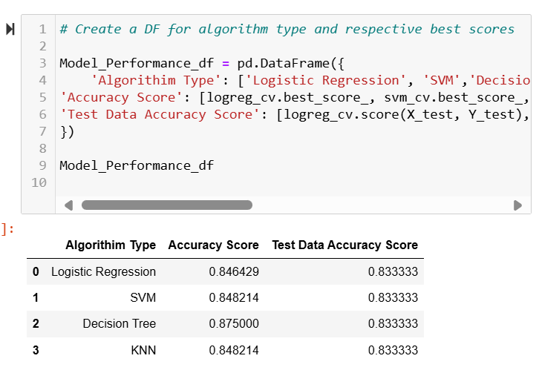
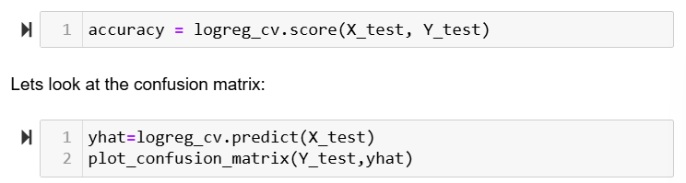
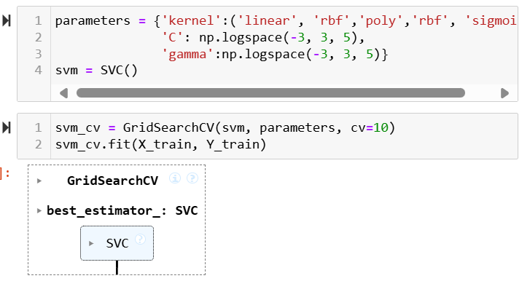
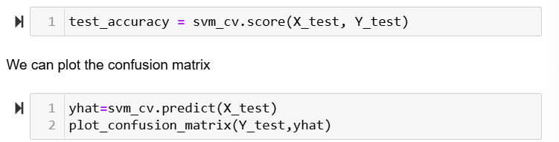
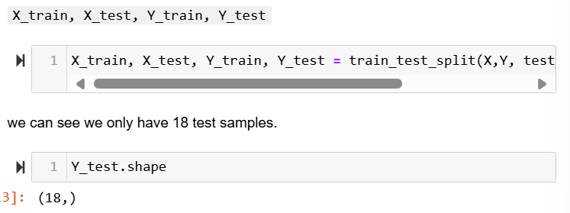
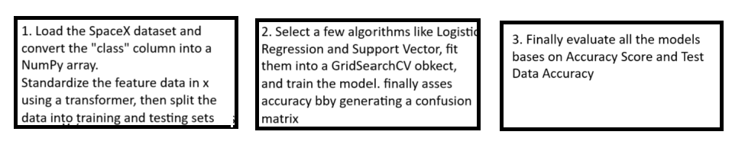
Predictive Analysis (Classification)
1
2
3
1
2
3

Slide 17
Results
The following slides will discuss these results
Exploratory data analysis results
Interactive analytics demo in screenshots
Predictive analysis results

Slide 18

Section 2

Slide 19
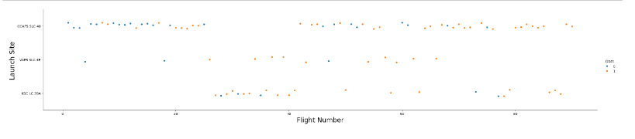
Flight Number vs. Launch Site
The scatter plot of Flight Number vs Launch Site reveals a positive correlation between the success rates of SpaceX landings as the number of launches increases.
This correlation is significant at the KSC LC 39A launch site because the first successful landing took almost 25 flights.
This correlation demonstrates SpaceX’s approach to refining its technology over time.

Slide 20
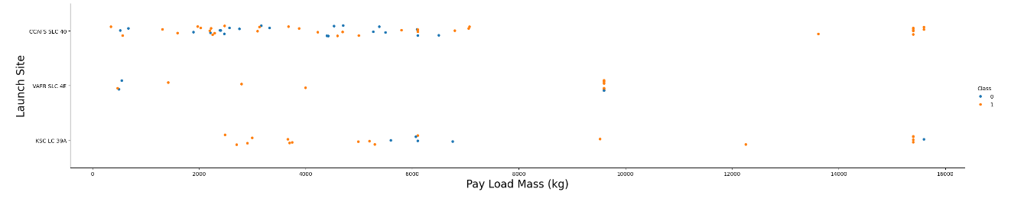
Payload vs. Launch Site
The scatter plot Payload vs. Launch site plot reveals insights into the distribution of payload masses across SpaceX launch sites.
This correlation is significant at the VAFB-SLC launch site because it doesn’t have rockets with heavy payloads, indicating potential limitations in either the site's payload capacity or the location of the site.
My conclusion is that there is no clear correlation between the payload mass and the launch site because other factors influence them.

Slide 21
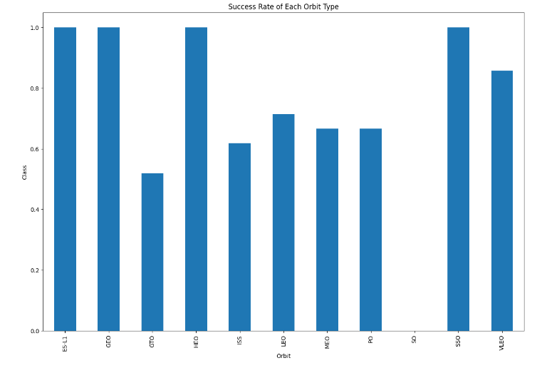
Success Rate vs. Orbit Type
The success rate vs. orbit type bar plot shows that orbits ES-L1, GEO, EO, and SSO have the highest success rates. However, the GTO orbit has the lowest success rate showing that launches to this orbit have lower chances of landing successfully.

Slide 22
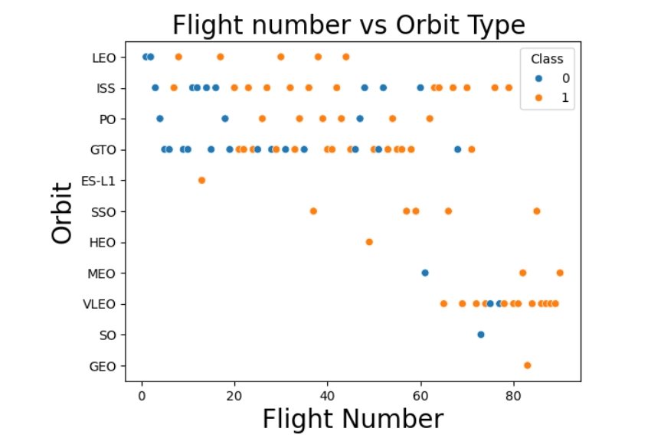
Flight Number vs. Orbit Type
The Flight Number vs. Orbit Type plot shows a positive correlation between flight frequency and launch success for lower earth orbit(LEO). This is because of SpaceX’s continuous improvement with repeated launches to LEO.
However, for the GTO (geostationary Transfer Orbit), there is no clear relationship on the plot, suggesting other factors may have influenced launch outcomes.

Slide 23
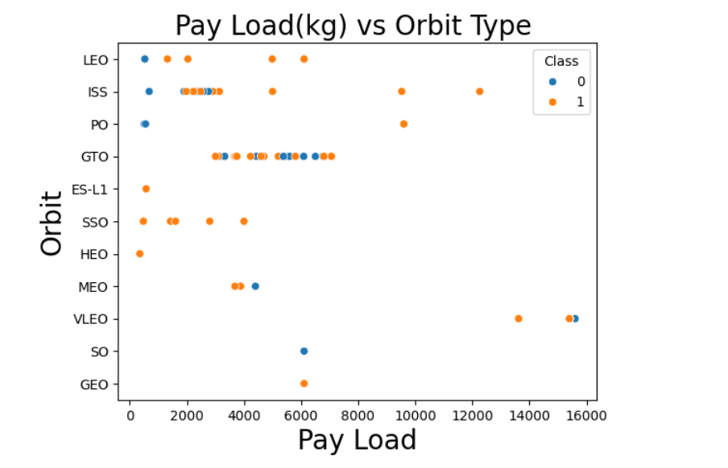
Payload vs. Orbit Type
The Payload vs. Orbit type plot shows that orbits LEO, Polar, and ISS have higher landing success rates for the heavier payloads. However, for the GTO orbits, the relationship is less clear, suggesting that other factors may influence the landing outcomes.

Slide 24
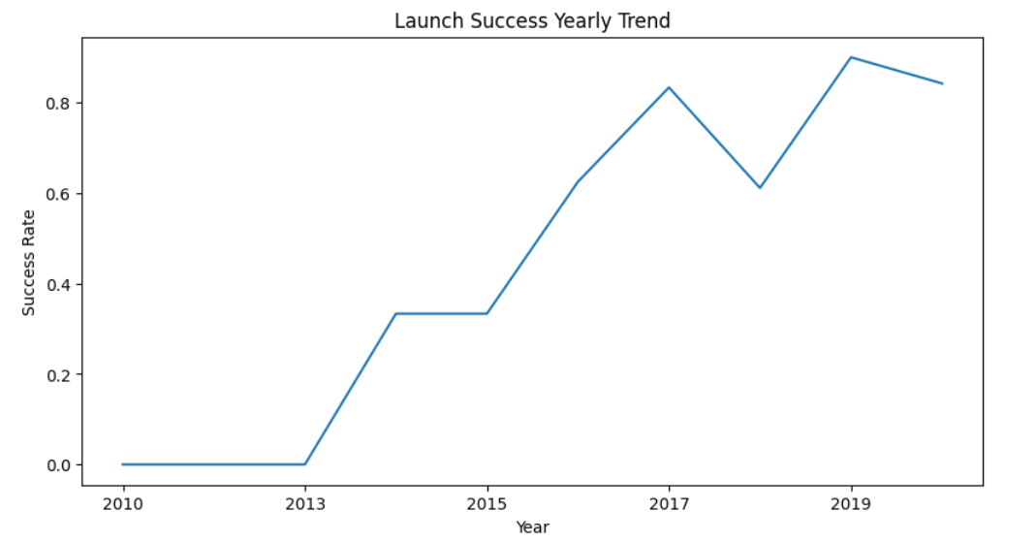
Launch Success Yearly Trend
The Yearly Launch Success Trend shows a huge improvement in the Flacon 9 landings since 2013, with success rates increasing by 80% by 2020, reflecting SpaceX’s improvement over time.

Slide 25
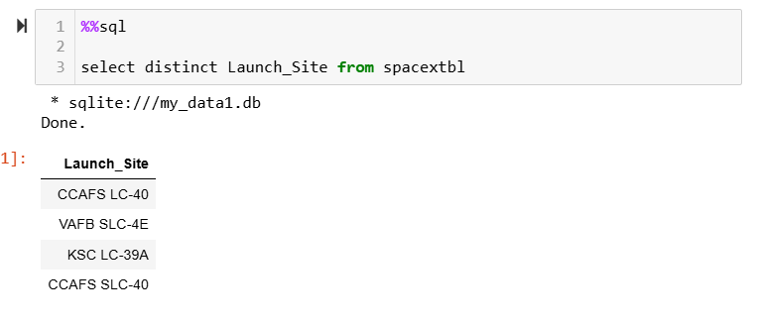
All Launch Site Names
SELECT DISTINCT is used to get unique values from the column, Launch_Site from the SPACEXTBL.

Slide 26
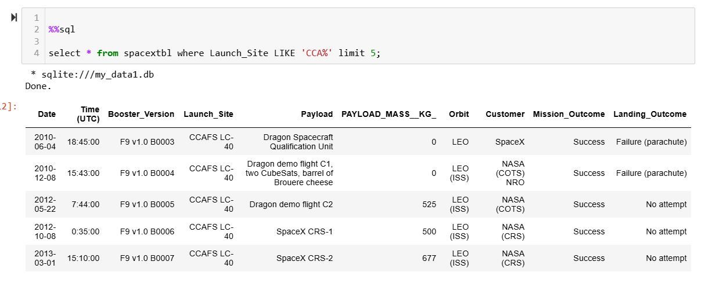
Launch Site Names Begin with 'CCA'
SELECT * gets all the columns from the SPACEXTABL and WHERE Launch_Site LIKE “CCA%” filters the rows where the Launch_Site starts with CCA and any characters following that. Finally, LIMIT 5 gets the output to display 5 records only.

Slide 27
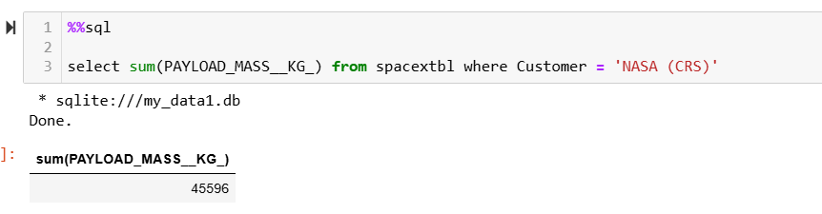
Total Payload Mass
SELECT SUM(PAYLOAD_MASS__KG_) calculates the total payload mass by summing up all the values in the PAYLOAD_MASS__KG_ column from the SPACEXTBL. Finally, WHERE Customer = ‘NASA (CRS)’ filters the records where the only missions conducted were by NASA’s Commercial Resupply Services (CRS).

Slide 28
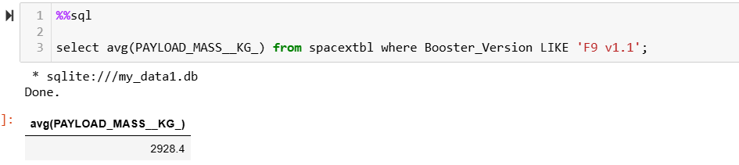
Average Payload Mass by F9 v1.1
SELECT AVG(PAYLOAD_MASS__KG_) calculates the average payload mass by averaging the values in the PAYLOAD_MASS__KG_ column from the SPACEXTBL. Finally, WHERE Booster_Version LIKE ”F9 v1.1” filters the records to only include records with the booster version F9 v1.1.

Slide 29
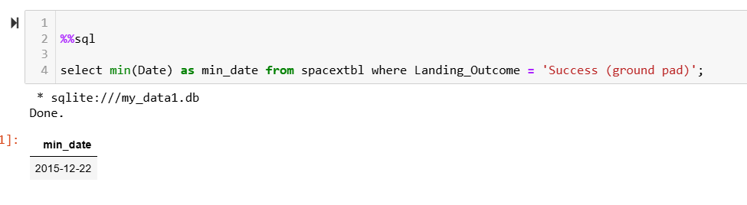
First Successful Ground Landing Date
SELECT MIN(Date) gets the earliest date from the Date column which represents the first successful landing, then, AS min_date renames the new column from the SPACEXTBL. Finally, WHERE Landing_Outcome = “Success (ground pad)” filters the records to only include successful landing outcomes on a ground pad.

Slide 30
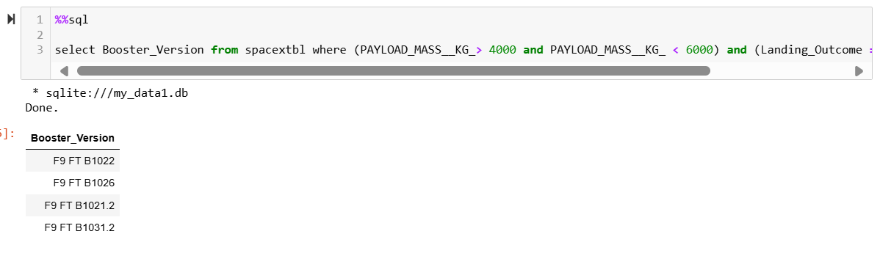
Successful Drone Ship Landing with Payload between 4000 and 6000
SELECT Booster_Version gets all the names of the boosters from the Booster_Version column in the SPACEXTBL. Then, WHERE (PAYLOAD_MASS__KG_ > 4000 AND PAYLOAD_MASS__KG_ < 6000) filters the records to include only those with a payload mass greater than 4000kg and less than 6000 kg. Finally, AND (Landing_Outcome = “Success (drone ship)”) filters the records again to only include those with successful landing outcomes on a drone ship.

Slide 31
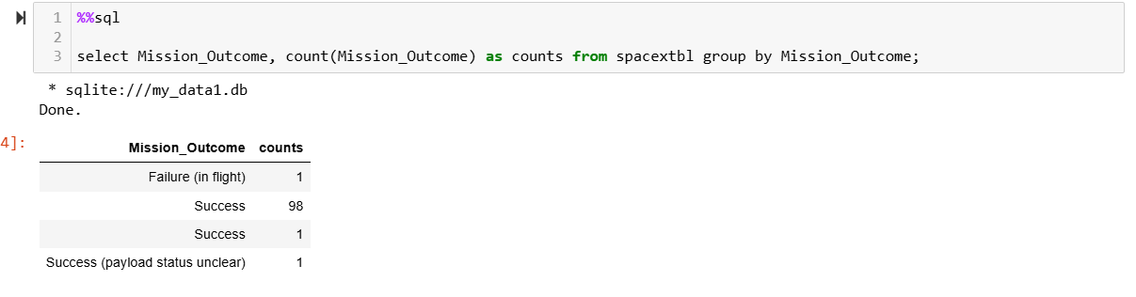
Total Number of Successful and Failure Mission Outcomes
SELECT Mission_outcome gets all the mission outcomes from the Mission_outcome column, then, COUNT(Mission_Outcome) AS Outcome_Count counts the number of times each mission outcome occurs, renames this new column as counts in the SPACEXTBL. Finally, GROUP BY Mission_outcome groups the results of each mission outcome.

Slide 32
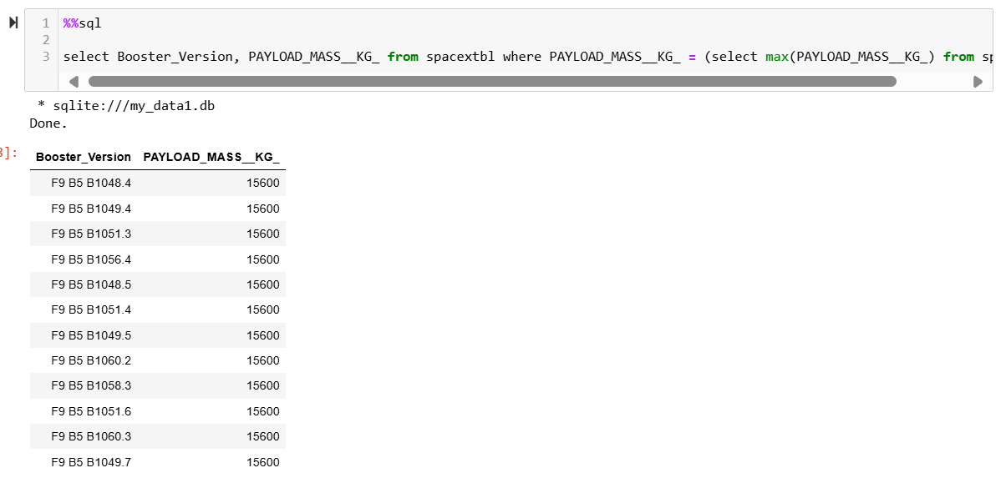
Boosters Carried Maximum Payload
SELECT Booster_Version, PAYLOAD_MASS__KG_ gets all the payload masses and all names of the boosters from the Booster_Version column in the SPACEXTBL. Then, WHERE PAYLOAD_MASS__KG_ = (SELECT MAX (PAYLOAD_MASS__KG_ ) FROM SPACEXTABL is a subquery that is used to find the maximum payload mass in the PAYLOAD_MASS__KG_ column and filters the records to only include boosters that carried the maximum payload.

Slide 33
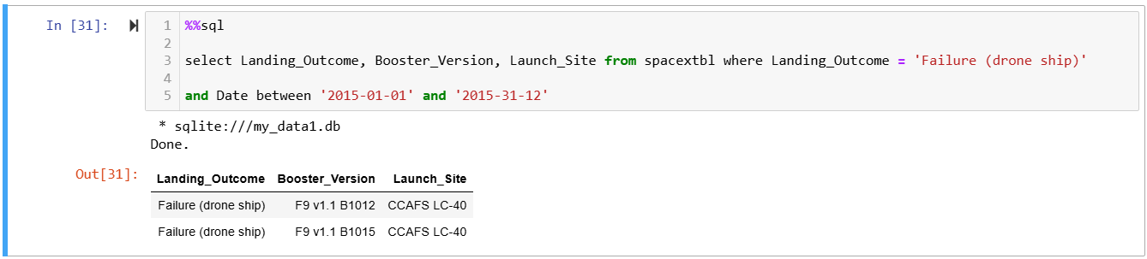
2015 Launch Records
SELECT Landing_Outcome, Booster_Version, and Launch_site gets all these columns from the SPACEXTBL, then, WHERE Landing_Outcome = “Failure (drone ship) ” filters the records to only include landing outcomes that failed on a drone ship. Finally, AND Date BETWEEN ‘2015-01-01’ and ‘2015-12-31’ to filter the records again to only include records from 2015.

Slide 34
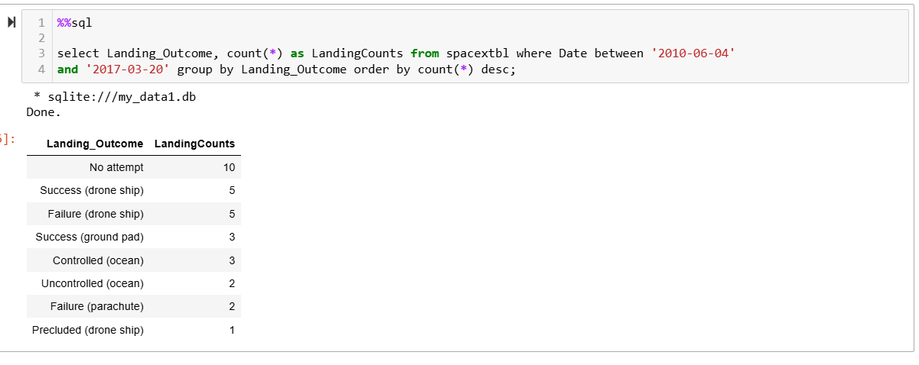
Rank Landing Outcomes Between 2010-06-04 and 2017-03-20
SELECT Landing_Outcome gets the landing outcomes from the Landing_Outcome column, then, COUNT(*) LandingCount counts the number of times each landing outcome occurs and renames this new column as LandingCounts from the SPACEXTBL. The WHERE Date BETWEEN ‘2010-06-04’ AND ‘2017-03-20’ filters the records to only include those within this date range. Finally, GROUP BY Landing_Outcome ORDER BY LandingCount DESC groups the results by reaching a unique landing outcome and then sorts the results in descending order based on the landing outcome.

Slide 35

Section 3

Slide 36
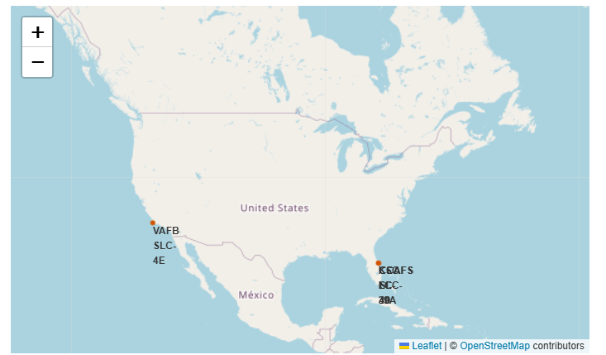
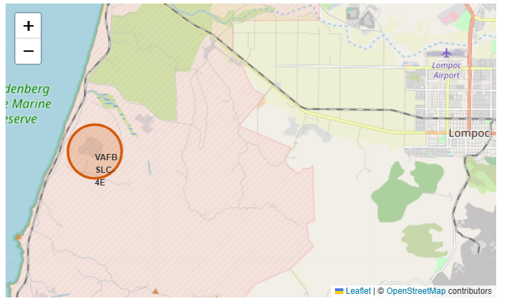
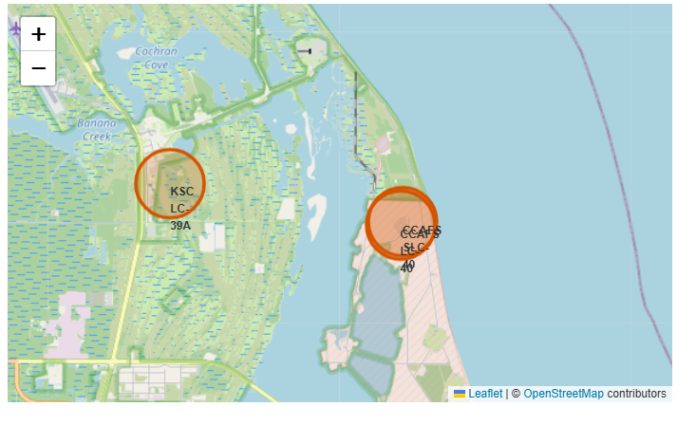
Launch Sites map for SpaceX Falcon9
The folium map of the SpaceX launch sites shows that they are located near coastlines and the equator. This enhances safety and the number of successful launches.

Slide 37
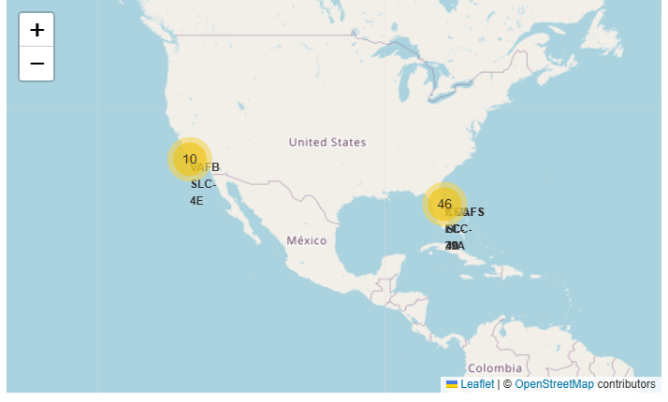

Successful & Failed Launches for each site on the map
The folium map displays SpaceX launch sites marked with color-coded outcomes for each launch
Green = successful launches
Red = failed launches

Slide 38

Launch Sites – Proximity Distance Map
The folium map highlights SpaceX launch sites near infrastructure such as coastlines, highways, and railways with distances to these features calculated and displayed.

Slide 39

Section 4

Slide 40

Launch Success Counts For all Sites
The launch success count for all sites in a pie chart shows the percentage of successful launches across SpaceX launch sites.
The chart shows that KSC LC- 39A has the highest success rate because this site delivered more consistently successful missions.
The chart shows that CCAFS SLC- 40 has the lowest success rate and this indicates that other factors may influence the unsuccessful missions

Slide 41

Launch site with Highest Success Ratio
This pie chart shows the launch success and failure rates for missions from the KSC LC-39A launch site.
KSC LC-39A showed a 76.9% launch success rate.
KSC LC-39A showed a 23.1% failure success rate.

Slide 42


Payload vs. Launch Outcomes Scatter Plot for all Sites
The Payload vs. Launch outcome scatter plot shows the most successful missions with a payload between 2000kg to 5500kg.
The FT (Falcon 9 thrust) booster version has the highest success rate across various payloads
The B4 booster is the only version to have success with payloads greater than 6000kg
This correlation shows that lower payload masses tend to have higher success rates.

Slide 43

Section 5

Slide 44

Classification Accuracy
The Decision Tree algorithm outperformed the other algorithms in predicting Falcon 9 stage landings, achieving the highest accuracy score of 0.875.

Slide 45

Confusion Matrix
The Decision Tree Classifier achieved an accuracy score of 0.875 in predicting the success of SpaceX Falcon 9 landings. The confusion matrix shows its classification performance (whether SpaceX Falcon 9 landings will land successfully or not ), showcasing true and false predictions for the Falcon 9 landing data.
The confusion matrix predicted that 11 scenarios were successful
Then, the confusion matrix predicted that 5 scenarios were successful
However, there 1 scenario was predicted yes for landing but did not land successfully, and another scenario was predicted no for landing but landing successfully.
Overall, the Decision Tree classifier demonstrates strong predictive qualities for Falcon 9 landings because it has a high accuracy score and minimal misclassifications.

Slide 46
Conclusions
Project Overview: Analyzed SpaceX’s Falcon9 first-stage landings using data collection and predictive analysis.
Data Collection: Sourced data via SpaceX API and performed data wrangling to prepare flight attributes for analysis.
Exploratory Data Analysis (EDA): Conducted EDA using visualizations and SQL queries to identify trends
Interactive mapping: Created an interactive map with folium to visualize launch site data, highlighting successful and failed launches
Dashboard Development: Developed a Ploty Dash dashboard for real-time analytics.
Predictive Modeling: Executed predictive analytics using various algorithms to predict mission success, identifying the best-performing model.

Slide 47
Appendix
Include any relevant assets like Python code snippets, SQL queries, charts, Notebook outputs, or data sets that you may have created during this project

Slide 48


